Slide 1

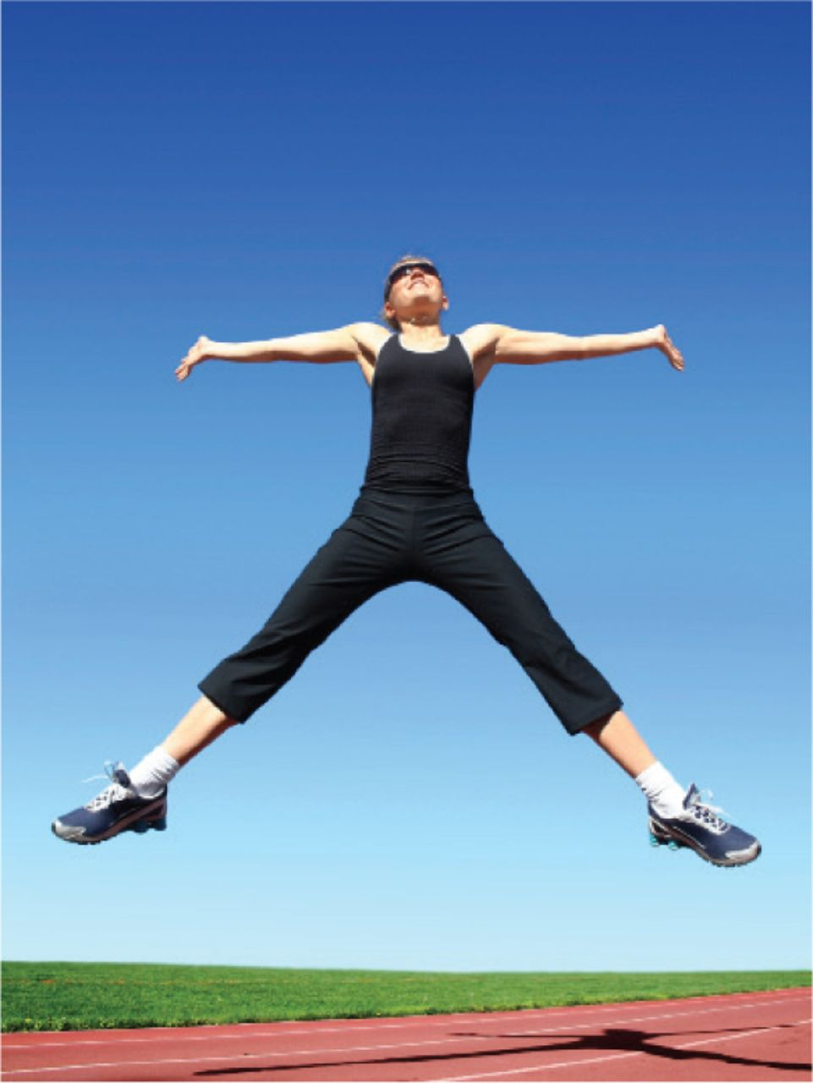
KS3 Fitness Tests and Challenges
Below are some fitness tests and challenges you can do at home with little equipment. Before you start, I would like you to do the following for each test:
1- Make sure you have had a good warm up (pulse raiser, stretching, mobility)
2- Read the instructions very carefully so you know how to perform the test
3- If you can, attempt the test 3 times to get an average score
4- Check the results table to see what category your score puts you in.
5- Write your score down as well as the category
Make sure you have fun, you could get family members to join in with you.

Slide 2
Feedback: It is very important that you are giving feedback to yourself by seeing which category your score falls in and then trying to improve it. For example, a performer scores 1min 40secs on the wall sit challenge and according to the table this would be a good score, so his/her target would be to improve the score and get into the excellent category.
Challenge: Can you beat Mrs Clarkes personal best (PB)?
You can find Mrs Clarkes personal best in the top right-hand corner of each fitness test!
Please ensure you write your scores in and then upload this document via assignments on Microsoft teams. Best of luck.

Slide 3
The Super Slalom Run Challenge
Equipment needed:
• Stopwatch
• Three Objects
Instructions:
1. Lay out 3 objects 3 steps apart
2. You must run in and out of the objects and back to the start
3. Running in and out and back to the start counts as 1 complete slalom run
4. Count how many slaloms you can complete in 1 minute
Mrs Clarke score is 20

Slide 4
3 steps apart
3 steps apart
Score:
Gender Excellent Above average Average Below Average Poor
Boys >18 17-14 13-10 9-6 <5
Girls >17 16-13 12-9 8-5 <4

Slide 5
The Speed Bounce Challenge
Equipment needed:
• Stopwatch
• A pillow or other object to jump over
Instructions:
• Two footed jump over the object
• Must take off and land on both feet
• Both feet must land over the object for the jump to count
• Every time you jump over the object this counts as 1 bounce
• Count how many bounces you can do in 1 minute
Gender Excellent Above average Average Below Average Poor
Boys >51 50-41 40-31 30-21 <20
Girls >49 48-39 38-29 28-19 <18

Slide 6
Mrs Clarkes score 75
Score:

Slide 7
Catch and Clap Challenge
Instructions:
• Throw the ball up in the air above your head
• Once the ball is in the air, clap once before catching the ball
• Every time you throw the ball up in the air, clap and catch the ball this counts as 1
• If you drop the ball, carry on counting your score from where you left off
• Count how many catches you can do in 1 minute
Equipment needed:
• Stopwatch
• A ball. (If you do not have a ball use a toilet roll or a pair of socks.)
Excellent Above average Average Below Average Poor
>22 21-17 16-12 11-7 <6

Slide 8
Mrs Clarkes score 40
Score:

Slide 9
Cha Cha Slide Plank Challenge
Equipment needed:
• Laptop/phone to play the video
Instructions:
• Copy this link into your browser: https://www.youtube.com/watch?v=x_YFkVSp34s
• Press play and follow the video
• Try to follow the workout for as long as you can
• If you stop, pause the video and note down the time
• Enjoy!
Score:
Mrs Clarkes PB the whole song
Excellent | Above average | Average | Below average | Poor
Full song | 1.59-1.40 | 1.39-1.10 | 1.09-0.40 | 0.39-0.10

Slide 10
How did you get on? Please remember to upload your scores and input your results into Microsoft teams.

